Slide 1
Front-End Developer 11 – 05.03.2018
Radovan Ostojić

Slide 2
Sadržaj časa
Java Script
String methods – functions
Javascript strings
Coding challenge

Slide 3
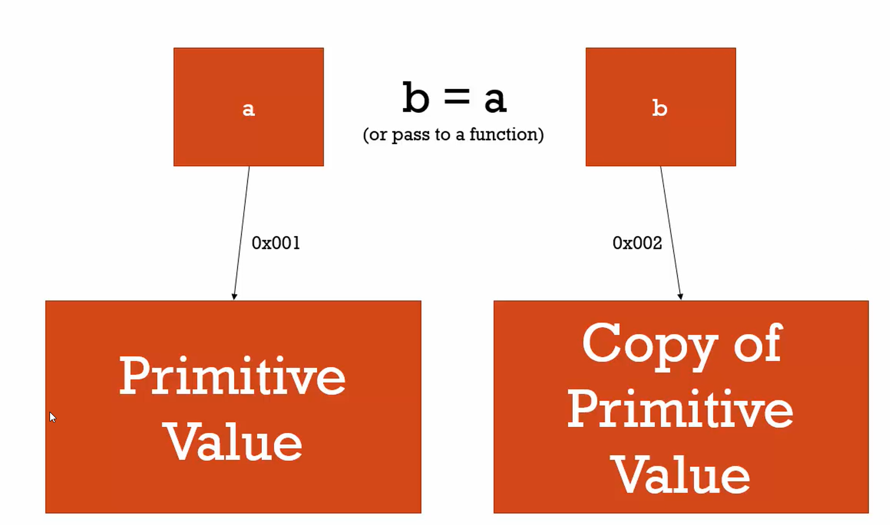
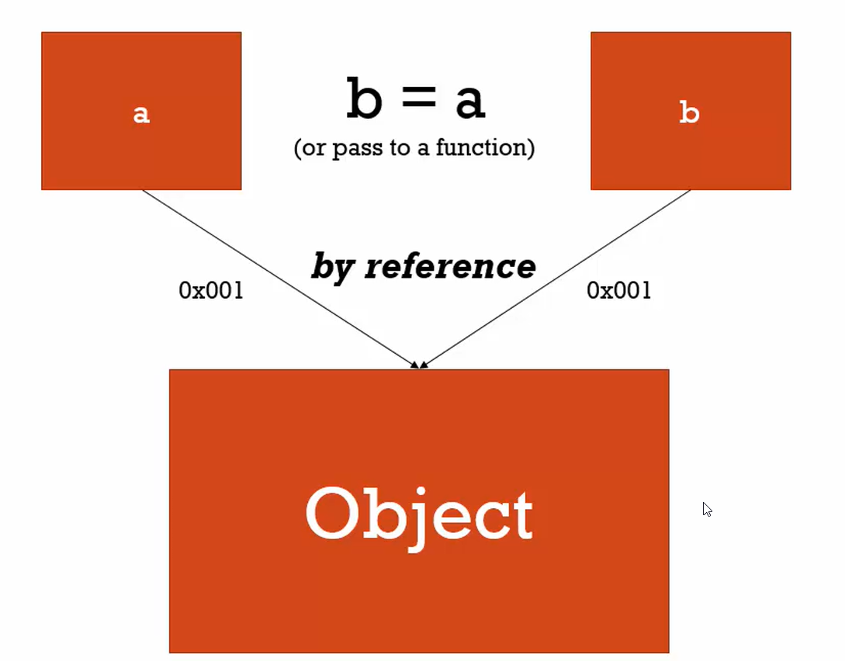

Ponavljanje je majka znanja ☺
Function expressions
Function statements
By Val vs By Ref

Slide 4
Sekcija
JavaScript
Lekcija
Strings

Slide 5
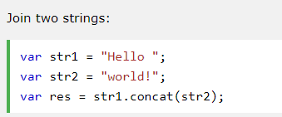
concat

Slide 6
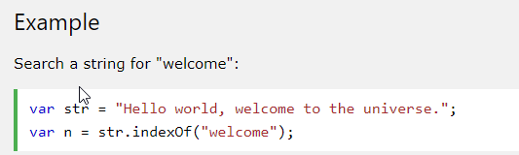
indexOf

Slide 7
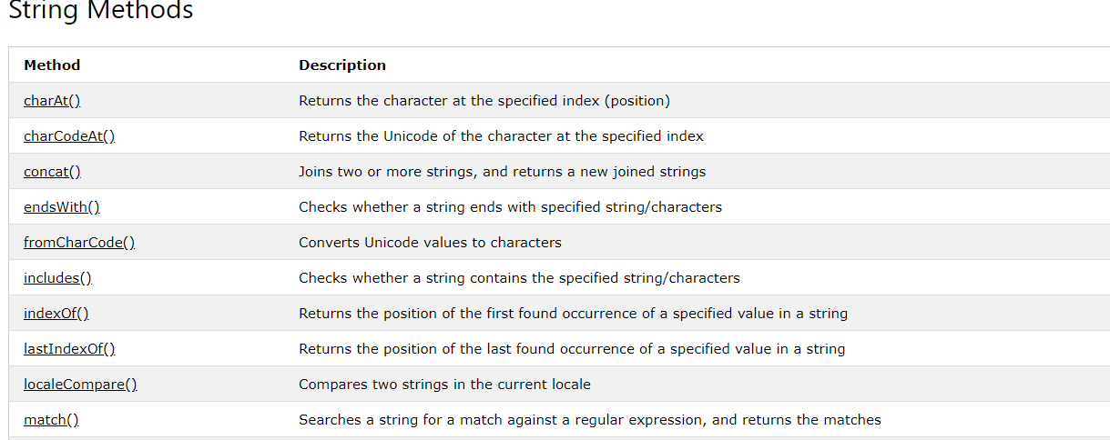
String Methods – part 1

Slide 8
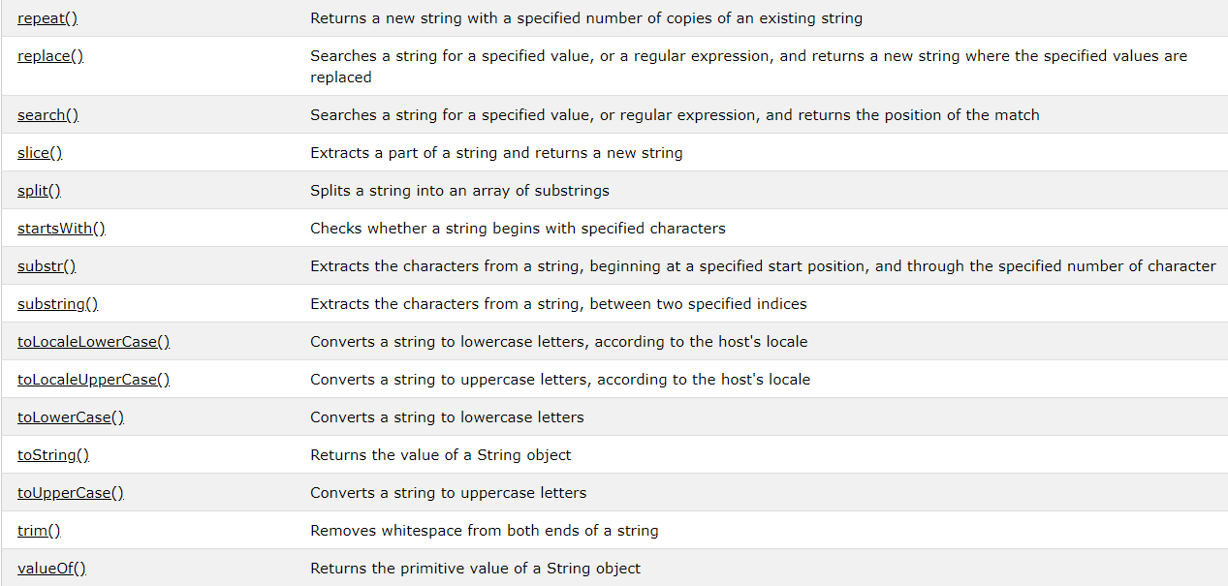
String Methods – part 2

Slide 9
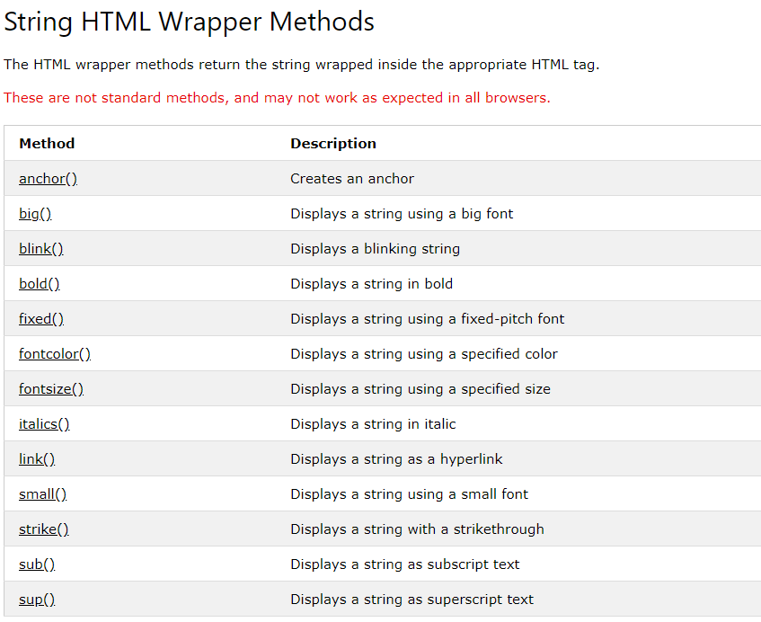
String HTML Wrapper Methods

Slide 10
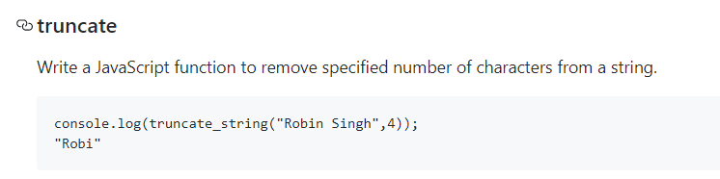
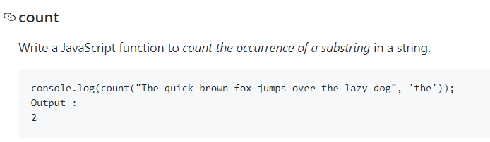
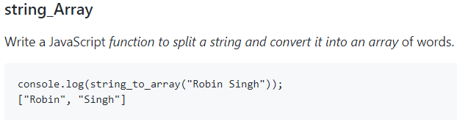
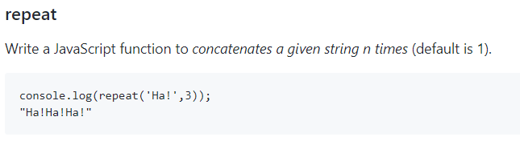
Coding challenges

